Slide 1
Atoms, molecules and stoichiometry
2.1 Relative masses of atoms and molecules
2.2 The mole and Avogadro constant
2.3 Formulae
2.4 Reacting masses and volumes (of solutions and gases)

Slide 2
Introduction
In the previous topic, you learnt about atoms, particles within the atoms and arrangement of elements in periodic table.
In this topic, you will learn to calculate mass of an atom. The actual mass of an atom is very small, and a new unit, mole, is required to represent this mass.
The terms Avogadro constant, molar mass and molar gas volume are also discussed. The method to derive empirical and molecular formulae of compounds using the mass by composition is discussed in detail.
The use of stoichiometric relationships in different calculations is highlighted in numerous example problems.

Slide 3
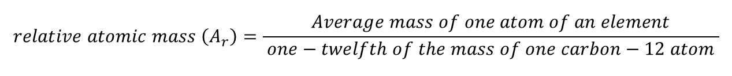
Isotopes & Calculating Relative Atomic Mass
The masses of an atom range from 10⁻²⁴ g to 10⁻²² g. To state the mass of an atom accurately, we measure their relative masses.
Relative atomic mass is the average mass of one atom of an element compared to one-twelfth of the mass of one carbon-12 atom.
Relative masses are ratios of two masses and, hence, do not have any units.
$$relative atomic mass \left(A_{r}\right)=\frac{Average mass of one atom of an element}{ one−twelfth of the mass of one carbon−12 atom }$$

Slide 4
Relative molecular mass
Relative molecular mass is the mass of one molecule compared to one-twelfth of the mass of one carbon-12 atom. It is usually calculated by adding the relative atomic mass of all the atoms in a molecule.
A water molecule (H₂O) consists of two atoms of hydrogen and one atom of oxygen. The relative atomic mass of hydrogen is 1. The relative atomic mass of oxygen is 16. The relative molecular mass of water = (1×2)+ 16=18
$$relative molecular mass \left(M_{r}\right)=\frac{Average mass of one molecule}{ one−twelfth of the mass of one carbon−12 atom }$$

Slide 5
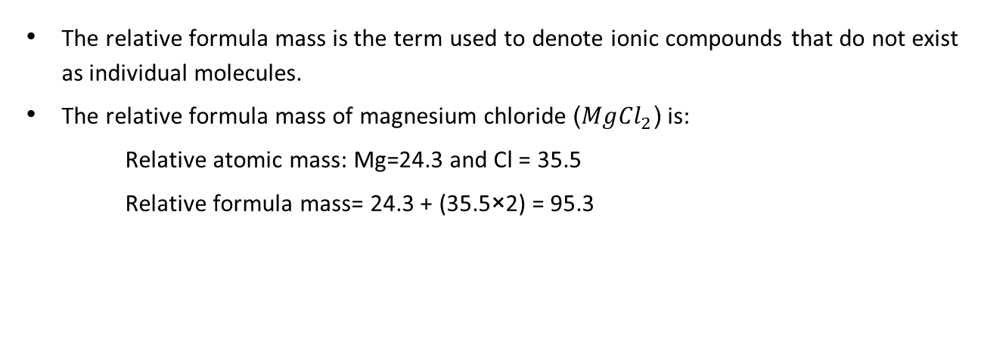
Relative molecular mass & relative formula mass
The relative formula mass is the term used to denote ionic compounds that do not exist as individual molecules.
The relative formula mass of magnesium chloride ($Mg{Cl}_{2}$) is:
  Relative atomic mass: Mg=24.3 and Cl = 35.5
  Relative formula mass= 24.3 + (35.5×2) = 95.3

Slide 6
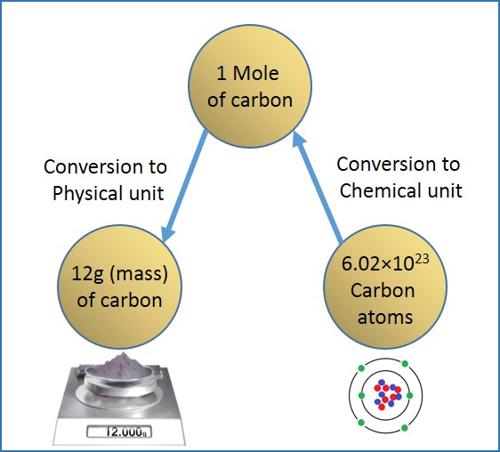
Mole and Avogadro Constant
One mole of substance is the amount of that substance that has the same number of specific particles (atoms, molecules and ions) as there are atoms in exactly 12 g of the carbon-12 isotope.
The number of atoms in one mole of atoms is 6.02×10²³. This number is called the Avogadro constant.
This rule holds good for atoms, molecules, ions and electrons.

Slide 7
Mole and Avogadro Constant
Examples:
Both one mole of sulphur and one mole of iron contain 6.02×10²³ atoms.
One mole of potassium chloride contains 1 mole of potassium ions and 1 mole of chloride ions, that is, 6.02×10²³ potassium ions and 6.02×10²³ chloride ions.
Similarly, a mole of carbon dioxide molecules consists of 1 mole of carbon atoms and 2 mole of oxygen atoms.

Slide 8
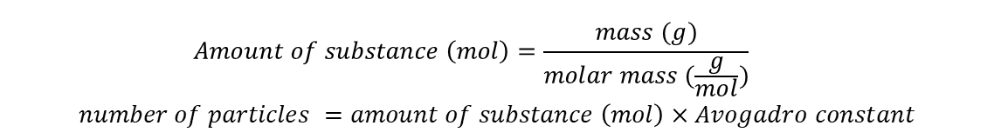
Mole and Avogadro Constant
The mass of a mole of the substance is called molar mass. The molar mass of an element is found on the periodic table and its unit is grams/mole.
The molar mass of a molecule is found by adding the individual atomic masses of its atoms.
In case of atoms, a mole (mol) is the number of atoms of a substance that make up the relative atomic mass, Ar in grams.
In case of molecules, a mole is the number of molecules of a substance that make up the relative molecular mass in grams.
$$Amount of substance \left(mol\right)=\frac{mass (g)}{molar mass (\frac{g}{mol})}$$
$$number of particles =amount of substance \left(mol\right)×Avogadro constant$$

Slide 9
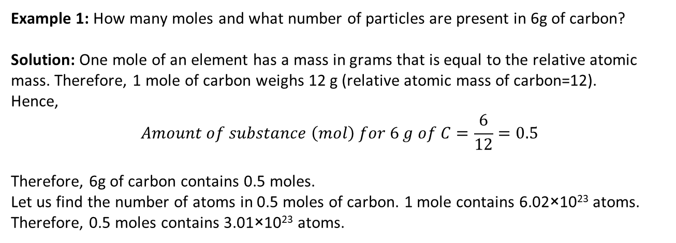
Mole and Avogadro Constant
Example 1: How many moles and what number of particles are present in 6g of carbon?
Solution: One mole of an element has a mass in grams that is equal to the relative atomic mass. Therefore, 1 mole of carbon weighs 12 g (relative atomic mass of carbon=12).
Hence,
$$Amount of substance \left(mol\right) for 6 g of C=\frac{6}{12}=0.5$$
Therefore, 6g of carbon contains 0.5 moles.
Let us find the number of atoms in 0.5 moles of carbon. 1 mole contains 6.02×10²³ atoms. Therefore, 0.5 moles contains 3.01×10²³ atoms.

Slide 10
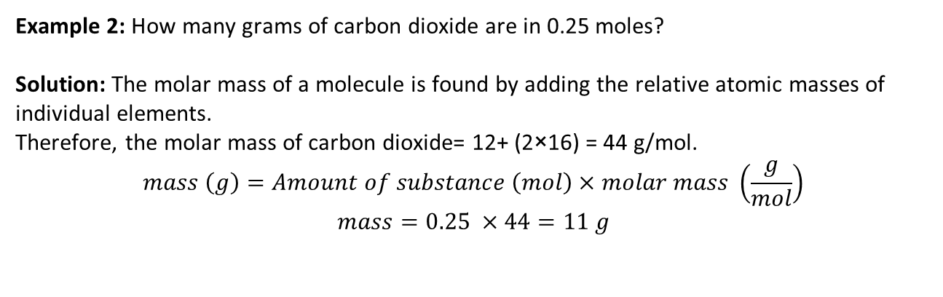
Mole and Avogadro Constant
Example 2: How many grams of carbon dioxide are in 0.25 moles?
Solution: The molar mass of a molecule is found by adding the relative atomic masses of individual elements.
Therefore, the molar mass of carbon dioxide= 12+ (2×16) = 44 g/mol.
$$mass \left(g\right)=Amount of substance \left(mol\right)×molar mass \left(\frac{g}{mol}\right)$$
$$mass=0.25 ×44=11 g$$

Slide 11
Hydrated Salts
Hydrated salts contain water of crystallisation. Anhydrous salts do not contain water of crystallisation.
When hydrated copper sulphate (blue crystalline solid) is heated, anhydrous copper sulphate (white powder) is obtained.
Hydrated copper(II) sulphate | Anhydrous copper sulphate
CuSO₄.5H₂O | CuSO₄
CuSO₄.5H₂O(s) → CuSO₄(s) + 5H₂O (g)

Slide 12
Hydrated Salts
Example 3: 9.04 g of hydrated sodium sulphate was heated, and 4.0 g of anhydrous sodium sulphate was obtained. How many water molecules are there in 1 molecule of hydrated sodium sulphate?
(Ar of Na= 23.0, S=32.1, O=16.0 and H=1.0)
Solution: Hydrated sodium sulphate is of the form Na₂SO₄.xH₂O where x is the number of water molecules.
Number of moles of Na₂SO₄= 4/142.04=0.028
Mass of water = 9.04-4.0=5.04 g
Number of moles of H₂O=5.04/18=0.28
Ratio of the number of moles of H₂O and Na₂SO₄=0.28/0.028=10
Hence, the formula for hydrated copper sulphate is Na₂SO₄.10H₂O.

Slide 13
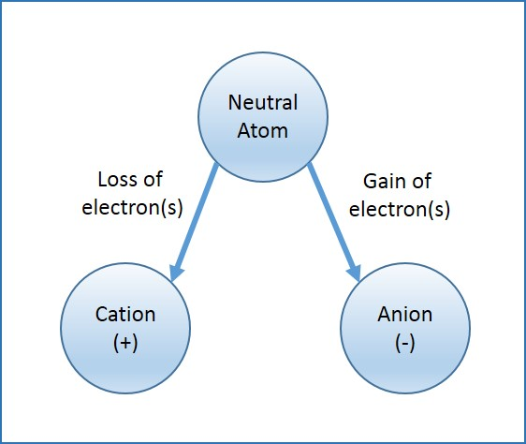
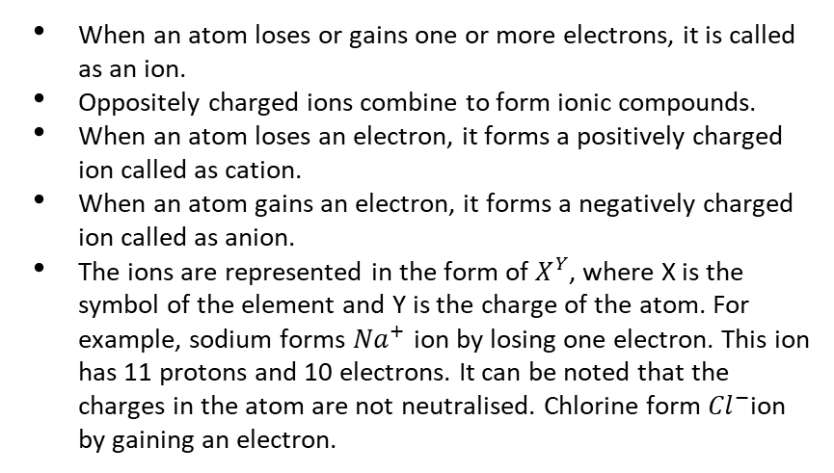
Ions
When an atom loses or gains one or more electrons, it is called as an ion.
Oppositely charged ions combine to form ionic compounds.
When an atom loses an electron, it forms a positively charged ion called as cation.
When an atom gains an electron, it forms a negatively charged ion called as anion.
The ions are represented in the form of $X^{Y}$, where X is the symbol of the element and Y is the charge of the atom. For example, sodium forms ${Na}^{+}$ ion by losing one electron. This ion has 11 protons and 10 electrons. It can be noted that the charges in the atom are not neutralised. Chlorine form ${Cl}^{−}$ion by gaining an electron.

Slide 14
Ionic charge of elements
Elements are arranged in periodic table according to atomic numbers and are assigned with group numbers. Group number denotes the number of electrons in the outermost shell.
  For example: Lithium, Sodium, Potassium, Rubidium, Caesium and Francium are group 1 elements. All these elements have one electron in the outermost shell and lose an electron to enter the stable state.
Group 2 elements have 2 electrons in the outermost shell and lose 2 electrons to form X²⁺ (X is the symbol for element) and enters the stable state.

Slide 15
Ionic charge of elements
Group 17 elements are called as halogens. Chlorine has atomic number of 17and its electronic configuration is 2, 8, 7. It needs one electron to reach stable configuration. Hence, chlorine gains one electron and becomes Cl⁻ ion. The table below shows the ionic charges of different elements.
+1 | +2 | +3 | -3 | -2 | -1
Group 1 elements Hydrogen (H) Silver (Ag) Gold (Au) | Group 2 elements Zinc (Zn) Copper(II) (Cu) Iron (II) (Fe) Tin (Sn) Lead (Pb) | Group 13 elements Iron (III) (Fe) | Group 15 elements | Group 16 elements | Group 17 elements

Slide 16
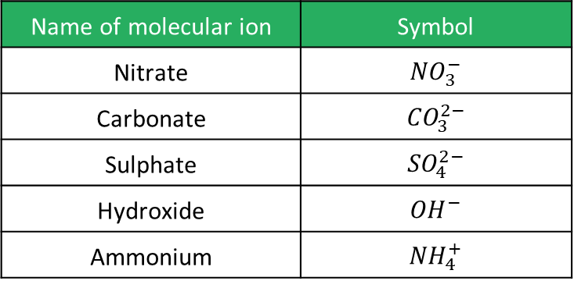
Molecular Ions
Molecular ions contain two or more ions that are bonded by a covalent bond.
Name of molecular ion | Symbol
Nitrate | $${NO}_{3}^{−}$$
Carbonate | $${CO}_{3}^{2−}$$
Sulphate | $${SO}_{4}^{2−}$$
Hydroxide | $${OH}^{−}$$
Ammonium | $${NH}_{4}^{+}$$

Slide 17
Empirical and Molecular Formula
The simplest formula of a compound is its empirical formula. It represents the number of atoms of each element in the simplest ratio.
Using composition of mass (n grams or percentage), the empirical formula can be calculated by using the following steps:
    Divide the composition of mass by the relative atomic mass.
    Divide the answer in step (i) by the smallest value obtained amongst the results
    Convert the number obtained in step (ii) to the nearest whole number by multiplying with a whole number to find the ratio of the number of atoms.

Slide 18
Empirical and Molecular Formula
Example 4: Find the empirical formula for the compound whose composition by mass is: iron - 72.3 % and oxygen - 27.7%.
Solution:
Fe (II) and O are in the ratio of 3:4 and, hence, the empirical formula is Fe₃O₄
Element | A_{r} | Composition by mass | Number of moles = Composition by mass/A_{r} | Divide by the smallest | Convert to whole number (×3)
Fe | 55.845 | 72.3 | 1.29 | 1 | 3
O | 16 | 27.2 | 1.7 | 1.3 | 4

Slide 19
Molecular Formula
The molecular formula denotes the actual number of elements in a compound. It is always a multiple of the empirical formula.
The molecular formula can be determined with the empirical formula and relative molecular mass.

Slide 20
Empirical and Molecular Formula
Example 5: What is the empirical formula of a hydrocarbon that contains 83.7 % carbon? Given that the relative molecular mass is 86, what is the molecular formula of this hydrocarbon?
Solution:
The empirical formula is C₃H₇. With a relative molecular mass of C₃H₇= 43.
But the relative molecular mass is 86.
86 ÷ 43 = 2 and, therefore, the molecular formula is C₆H_{14.}
Element | A_{r} | Composition by mass | Composition by mass/A_{r} | Divide by the smallest | Convert to whole number (×3)
C | 12 | 83.7 | 6.98 | 1 | 3
H | 1 | 16.3 | 16.3 | 2.33 | 7

Slide 21
Constructing Balanced Chemical Equations
A chemical equation represents a chemical reaction in shorthand form. The chemical formulae of reactants and products are used. The different state symbols used in equations are:
Symbol | State
s | solid
l | liquid
g | gas
aq | aqueous (solution in water)

Slide 22

Constructing Balanced Chemical Equations
Example 6: Heating lithium carbonate produces lithium oxide and carbon dioxide. This reaction is represented in equation form as
$${Li}_{2}CO_{3}→{Li}_{2}O+CO_{2}$$
Element | Number of atoms |  | Balanced?
 | Reactant side | Product side
Li | 2 | 2 | Yes
C | 1 | 1 | Yes
O | 3 | 3 | Yes

Slide 23


Constructing Balanced Chemical Equations
Example 6: Continued.
The above chemical equation is balanced as the number of atoms for each element is the same on both the reactant and product side. It is also important to insert the information about the states of the reactants and products. Additional information such as temperature or pressure is given above the arrow mark.
$${Li}_{2}CO_{3}→{Li}_{2}O+CO_{2}$$
${Li}_{2}CO_{3}\left(s\right)\underset{→}{heat}{Li}_{2}O(s)+CO_{2}(g)$

Slide 24
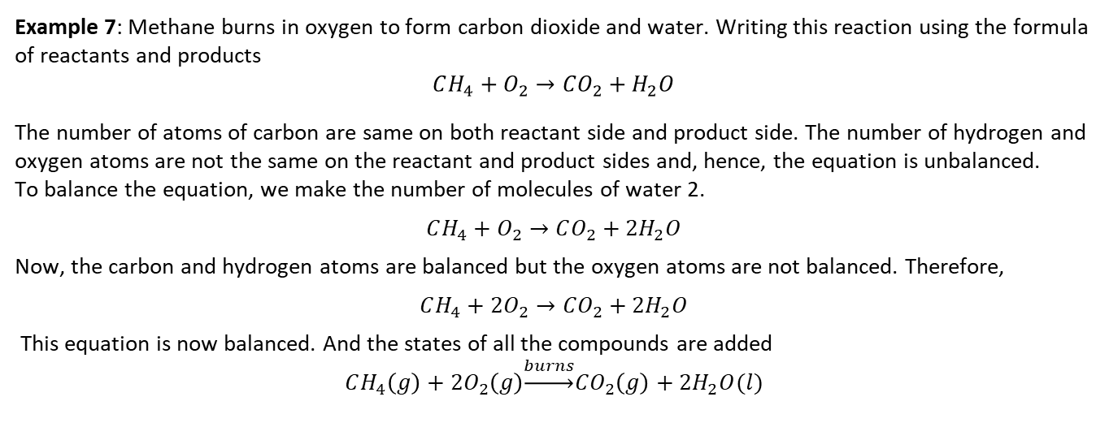
Constructing Balanced Chemical Equations
Example 7: Methane burns in oxygen to form carbon dioxide and water. Writing this reaction using the formula of reactants and products
$$CH_{4}+O_{2}→CO_{2}+H_{2}O$$
The number of atoms of carbon are same on both reactant side and product side. The number of hydrogen and oxygen atoms are not the same on the reactant and product sides and, hence, the equation is unbalanced.
To balance the equation, we make the number of molecules of water 2.
$$CH_{4}+O_{2}→CO_{2}+{2H}_{2}O$$
Now, the carbon and hydrogen atoms are balanced but the oxygen atoms are not balanced. Therefore,
$$CH_{4}+{2O}_{2}→CO_{2}+{2H}_{2}O$$
This equation is now balanced. And the states of all the compounds are added
$$CH_{4}\left(g\right)+{2O}_{2}\left(g\right)\underset{→}{burns}CO_{2}\left(g\right)+{2H}_{2}O(l)$$

Slide 25
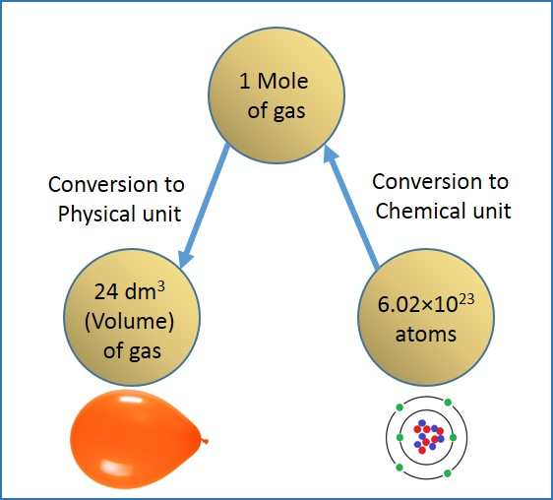
Molar Gas Volume
For gases, measuring volume is more convenient than calculating mass.
Avogadro discovered that equal volumes of gases at the same temperature and pressure contain the same number of atoms.
One mole of a gas occupies 24 dm³ (1 m³=1000 dm³) at standard pressure (1 atm) and temperature (273 K). Therefore, the molar gas volume is 24 dm³/mol.
$$Volume of gas ({dm}^{3})=number of moles ×24$$

Slide 26
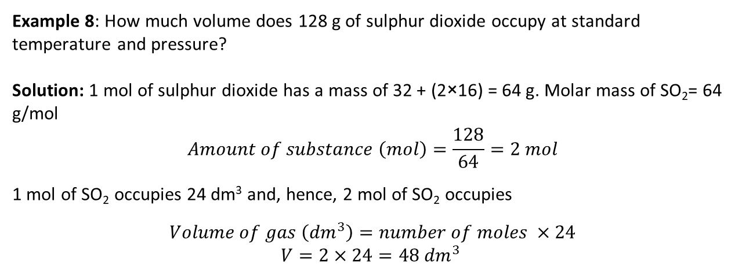
Molar Gas Volume
Example 8: How much volume does 128 g of sulphur dioxide occupy at standard temperature and pressure?
Solution: 1 mol of sulphur dioxide has a mass of 32 + (2×16) = 64 g. Molar mass of SO₂= 64 g/mol
$$Amount of substance \left(mol\right)=\frac{128}{64}=2 mol$$
1 mol of SO₂ occupies 24 dm³ and, hence, 2 mol of SO₂ occupies
$$Volume of gas \left({dm}^{3}\right)=number of moles ×24$$
$$V=2×24=48 {dm}^{3}$$

Slide 27
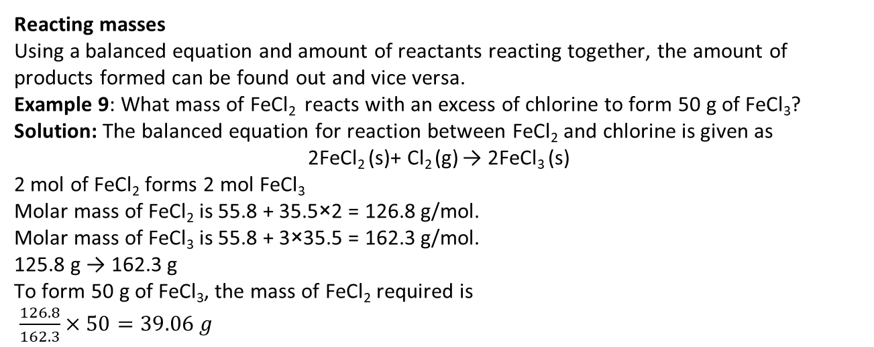
Calculations
  Reacting masses
Using a balanced equation and amount of reactants reacting together, the amount of products formed can be found out and vice versa.
Example 9: What mass of FeCl₂ reacts with an excess of chlorine to form 50 g of FeCl₃?
Solution: The balanced equation for reaction between FeCl₂ and chlorine is given as
2FeCl₂ (s)+ Cl₂ (g) → 2FeCl₃ (s)
2 mol of FeCl₂ forms 2 mol FeCl₃
Molar mass of FeCl₂ is 55.8 + 35.5×2 = 126.8 g/mol.
Molar mass of FeCl₃ is 55.8 + 3×35.5 = 162.3 g/mol.
125.8 g → 162.3 g
To form 50 g of FeCl₃, the mass of FeCl₂ required is
$\frac{126.8}{162.3}×50=39.06 g$

Slide 28
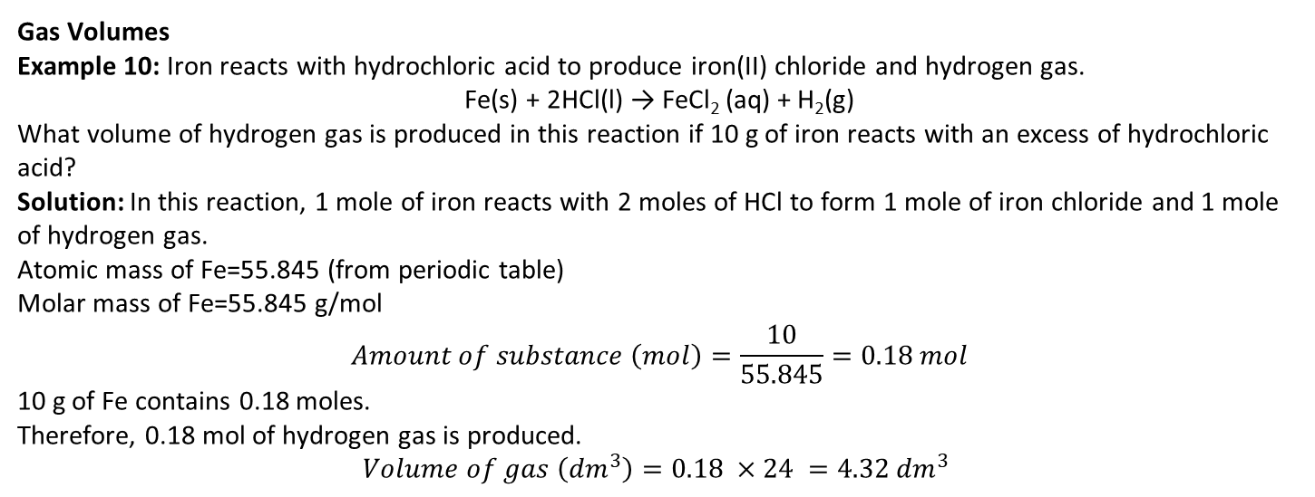
Calculations
  Gas Volumes
  Example 10: Iron reacts with hydrochloric acid to produce iron(II) chloride and hydrogen gas.
Fe(s) + 2HCl(l) → FeCl₂ (aq) + H₂(g)
What volume of hydrogen gas is produced in this reaction if 10 g of iron reacts with an excess of hydrochloric acid?
Solution: In this reaction, 1 mole of iron reacts with 2 moles of HCl to form 1 mole of iron chloride and 1 mole of hydrogen gas.
Atomic mass of Fe=55.845 (from periodic table)
Molar mass of Fe=55.845 g/mol
$$Amount of substance \left(mol\right)=\frac{10}{55.845}=0.18 mol$$
10 g of Fe contains 0.18 moles.
Therefore, 0.18 mol of hydrogen gas is produced.
$$Volume of gas \left({dm}^{3}\right)=0.18 ×24 =4.32 {dm}^{3}$$

Slide 29
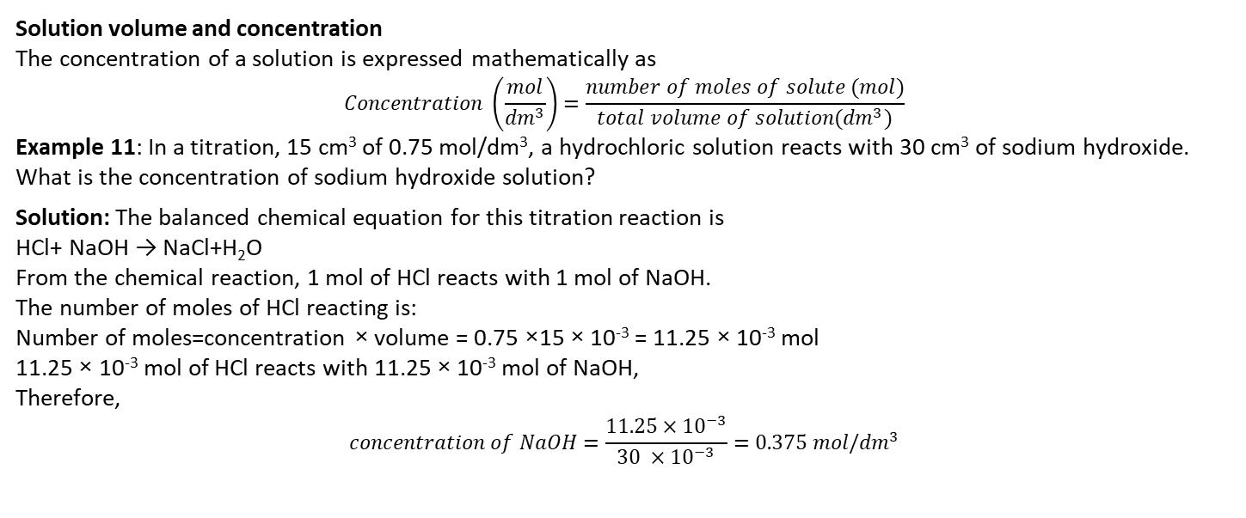
Calculations
  Solution volume and concentration
The concentration of a solution is expressed mathematically as
$$Concentration \left(\frac{mol}{{dm}^{3}}\right)=\frac{number of moles of solute (mol)}{total volume of solution({dm}^{3})}$$
Example 11: In a titration, 15 cm³ of 0.75 mol/dm³, a hydrochloric solution reacts with 30 cm³ of sodium hydroxide. What is the concentration of sodium hydroxide solution?
Solution: The balanced chemical equation for this titration reaction is
HCl+ NaOH → NaCl+H₂O
From the chemical reaction, 1 mol of HCl reacts with 1 mol of NaOH.
The number of moles of HCl reacting is:
Number of moles=concentration × volume = 0.75 ×15 × 10⁻³ = 11.25 × 10⁻³ mol
11.25 × 10⁻³ mol of HCl reacts with 11.25 × 10⁻³ mol of NaOH,
Therefore,
$$concentration of NaOH=\frac{11.25×{10}^{−3}}{30 ×{10}^{−3}}=0.375 mol/{dm}^{3}$$

Slide 30
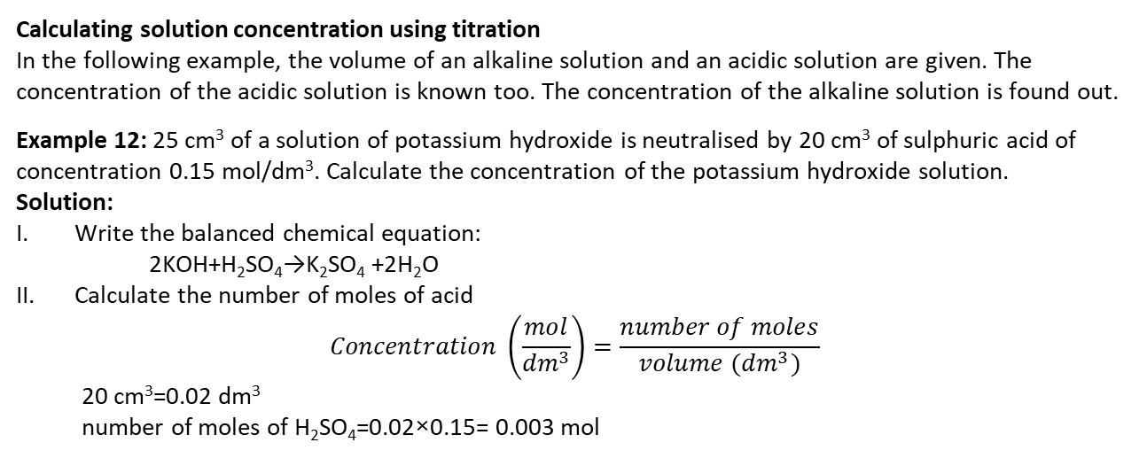
Titration Calculations based on experimental results
Calculating solution concentration using titration
In the following example, the volume of an alkaline solution and an acidic solution are given. The concentration of the acidic solution is known too. The concentration of the alkaline solution is found out.
Example 12: 25 cm³ of a solution of potassium hydroxide is neutralised by 20 cm³ of sulphuric acid of concentration 0.15 mol/dm³. Calculate the concentration of the potassium hydroxide solution.
Solution:
Write the balanced chemical equation:
2KOH+H₂SO₄→K₂SO₄ +2H₂O
Calculate the number of moles of acid
$$Concentration \left(\frac{mol}{{dm}^{3}}\right)=\frac{number of moles}{volume ({dm}^{3})}$$
    20 cm³=0.02 dm³
    number of moles of H₂SO₄=0.02×0.15= 0.003 mol

Slide 31
Titration Calculations based on experimental results
Calculate the number of moles of KOH,
2 mol of KOH requires 1 mol of H₂SO₄ for neutralisation.
Therefore, the number of moles of KOH= (number of moles of H₂SO₄ )×2
number of moles of KOH=0.003×2=0.006 mol
Calculate the concentration of KOH
$$Concentration \left(\frac{mol}{{dm}^{3}}\right)=\frac{0.006}{0.025 ({dm}^{3})}$$
  The concentration of KOH solution is 0.24 mol/ dm³.

Slide 32
Titration Calculations based on experimental results
Calculating stoichiometry by titration
Example 2: 25 cm³ of a 0.060 mol/dm³ of a metal hydroxide reacts with 0.200 mol/ dm³ of acid. 15 cm³ of hydrochloric acid solution is required to neutralise the alkaline solution. Find out the stoichiometry of this reaction.
Solution:
Find the number of moles of both the acidic and alkaline solutions.
For the alkaline solution,
number of moles=concentration × volume = 0.025× 0.060=0.0015 mol
For the acidic solution,
number of moles= concentration × volume = 0.200 × 0.015 =0.0030 mol
Find out the ratio between the number of moles of acid and metal hydroxide.
Number of moles of alkaline: number of moles of acid = 1.5 × 10⁻³: 3.0 ×10⁻³ = 1: 2

Slide 33
Titration Calculations based on experimental results
Calculating stoichiometry by titration
Example 13: 25 cm³ of a 0.060 mol/dm³ of a metal hydroxide reacts with 0.200 mol/ dm³ of acid. 15 cm³ of hydrochloric acid solution is required to neutralise the alkaline solution. Find out the stoichiometry of this reaction.
Solution: (Continued.)
One mole of hydroxide ion neutralises one mole of hydrogen ions in the case of neutralisation. In this reaction, 2 moles of acids are neutralised by one mole of metal hydroxide. Hence, the balanced equation is
metal hydroxide + 2 acid → salt + water
M(OH)₂ + 2 HCl → MCl₂ + H₂O

Slide 34
More Titration Calculations
Example 14: 20 cm³ of a sample of ethanoic acid is taken and the volume is made up to 200 cm³. This solution is taken in a burette and 14.5 cm³ was required to neutralise 25 cm³ of 0.02 mol/dm³ of magnesium hydroxide. Calculate the molarity of the original ethanoic acid and give the concentration in g/ dm³.
Solution:
Write the balanced equation of the reaction between ethanoic acid and magnesium hydroxide.
2 CH₃COOH + Mg (OH)₂ → (CH₃COO)₂Mg+ 2H₂O
Find the molarity (number of moles) of magnesium hydroxide solution,
number of moles = concentration × volume
number of moles = 0.02 × 0.025 =0.0005 mol
Using the balanced equation, it can be deduced that 1 mol of magnesium hydroxide requires 2 mol of ethanoic acid. Therefore,
The number of moles of ethanoic acid = 0.0005 × 2=0.0010 mol

Slide 35
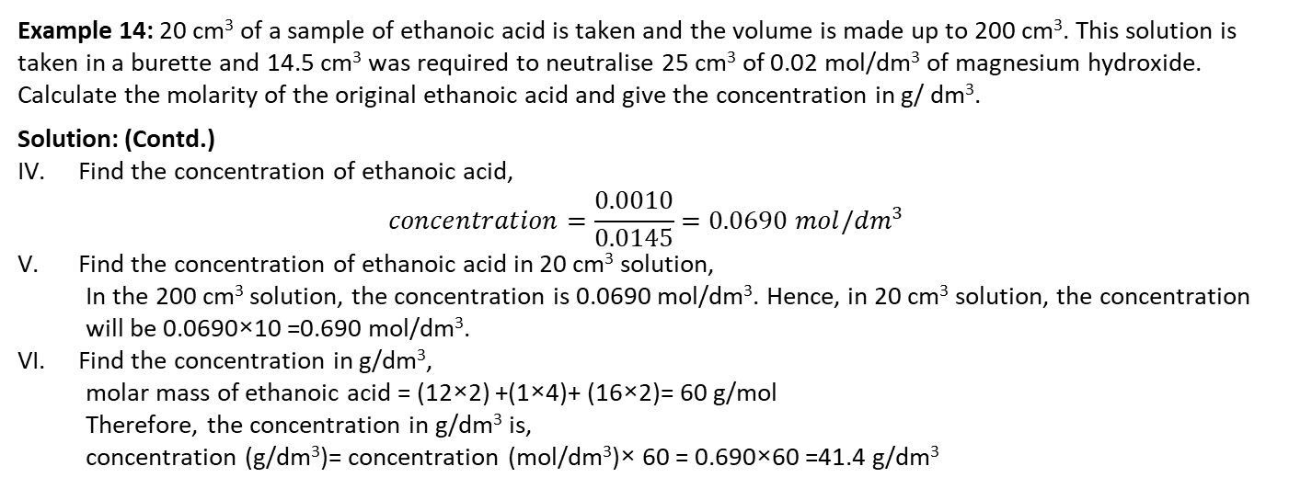
More Titration Calculations
Example 14: 20 cm³ of a sample of ethanoic acid is taken and the volume is made up to 200 cm³. This solution is taken in a burette and 14.5 cm³ was required to neutralise 25 cm³ of 0.02 mol/dm³ of magnesium hydroxide. Calculate the molarity of the original ethanoic acid and give the concentration in g/ dm³.
Solution: (Contd.)
Find the concentration of ethanoic acid,
$$concentration=\frac{0.0010}{0.0145}=0.0690 mol/{dm}^{3}$$
Find the concentration of ethanoic acid in 20 cm³ solution,
In the 200 cm³ solution, the concentration is 0.0690 mol/dm³. Hence, in 20 cm³ solution, the concentration will be 0.0690×10 =0.690 mol/dm³.
Find the concentration in g/dm³,
molar mass of ethanoic acid = (12×2) +(1×4)+ (16×2)= 60 g/mol
Therefore, the concentration in g/dm³ is,
concentration (g/dm³)= concentration (mol/dm³)× 60 = 0.690×60 =41.4 g/dm³

Slide 36

Identifying the Limiting & Excess Reagent
The reactant that is completely used up in a reaction is called limiting reagent. The reactant that does not get used up completely in a reaction is called excess reagent.
Example 15: Calculate the maximum mass of copper that can be produced by reacting 90 g of CuCl₂ with 40 g of Al?
Solution:
Writing the balanced equation,
2Al+3CuCl₂ → 3Cu+2AlCl₃
Calculating the number of moles of CuCl₂ and Al:
For CuCl₂,
$$number of moles=\frac{mass}{molar mass}$$
$$number of moles=\frac{90}{134.45}=0.669 mol$$
For Al,
$$number of moles=\frac{40}{26.98}=1.48 mol$$

Slide 37
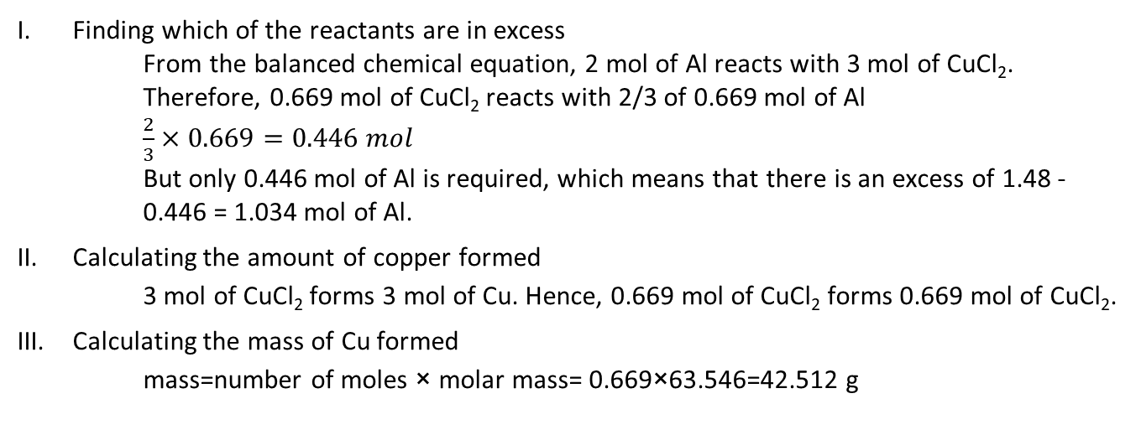
Identifying the Limiting & Excess Reagent
Finding which of the reactants are in excess
From the balanced chemical equation, 2 mol of Al reacts with 3 mol of CuCl₂. Therefore, 0.669 mol of CuCl₂ reacts with 2/3 of 0.669 mol of Al
$\frac{2}{3}×0.669=0.446 mol$
But only 0.446 mol of Al is required, which means that there is an excess of 1.48 - 0.446 = 1.034 mol of Al.
Calculating the amount of copper formed
3 mol of CuCl₂ forms 3 mol of Cu. Hence, 0.669 mol of CuCl₂ forms 0.669 mol of CuCl₂.
Calculating the mass of Cu formed
mass=number of moles × molar mass= 0.669×63.546=42.512 g

